Slide 1
Ride Sharing Fare Estimation
Springboard Data Science Career Track
Second Capstone Project
Yan Xu
June 4th, 2019

Slide 2


Introduction
Ride sharing company in line to IPO
Ride sharing service grow exponentially
Strong interest in fare calculation as a regular user
Develop a pricing model for ride sharing service

Slide 3

Dataset information
Source: City of Chicago Open Data Portal
Original dataset contains: 17.4 Million entries with 21 variables.
Original dataset date range: November 2018 to March 2019
Random sampling of size 1 Million entries

Slide 4
Data variables
Unique ID variables: Trip ID
Time variables: Trip Start Timestamp, Trip End Timestamp
Trip Information variables: Trip Seconds, Trip Miles
Spatial variables: Pickup Census Tract, Dropoff Census Tract, Pickup Community Area, Dropoff Community Area, Pickup Centroid Latitude, Pickup Centroid Longitude, Pickup Centroid Location, Dropoff Centroid Latitude, Dropoff Centroid Longitude, Dropoff Centroid Location
Monetary variables: Fare, Tip, Additional Charges, Trip Total
Carpool indicator variables: Shared Trip Authorized, Trips Pooled

Slide 5

Data cleaning
Spatial variables are out of project scope
Monetary variables only include Fare
Reduce dataset to 9 variables.
Impute missing data in Trip Second
Replace all empties with 0 for Pickup Community Area and Dropoff Community Area to indicate area outside Chicago
Convert timestamp to day of week

Slide 6
Exploratory Data Analysis
ANOVA on Fare, Trip_seconds, Trip_miles against day of week
Low p-value – is significant difference among the average values for at least one of the week day
Correlation - positive correlation between Fare and Trip Seconds; positive correlation between Fare and Trip Miles
Chi-Square – (Shared Trip Authorized, Pickup Community Area, and Dropoff Community Area )verse weekday, low p-value, depend on each other

Slide 7
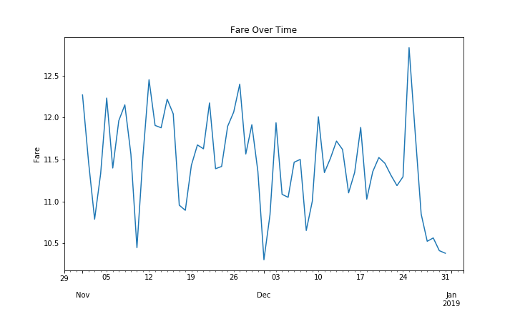
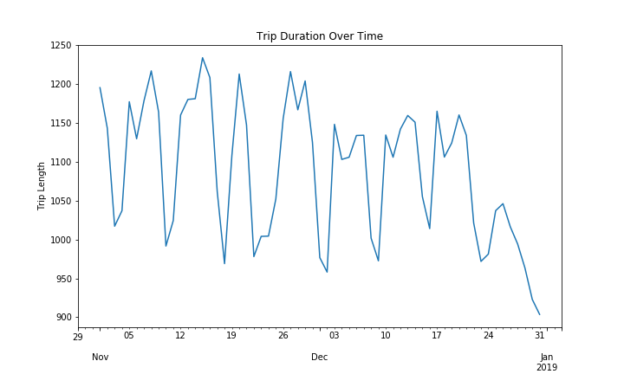
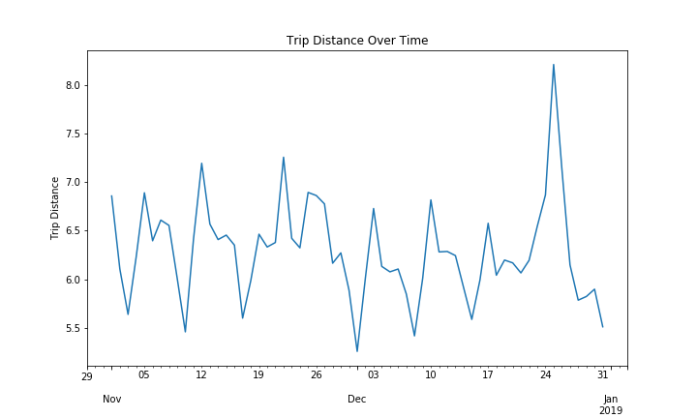
Time analysis
 | Overall Trend | Fluctuation | Spike
Fare over time | No downward or upward | Random | Right after Christmas Eve
Trip Duration over time | Downward | Random | No observations
Trip Distance over time | No downward or upward | Random | Right after Christmas Eve

Slide 8
Model-pre processing
Create Dummy variable columns for categorical variables. Variables increased from 10 to 174
Split Data into Target variable ( FARE) and Feature variables.
Exclude the original categorical variables.
Interaction term between Trip_seconds and Trip_miles has a low p-value in OLS analysis, retain both.
Data then split into 70% Training set, 30% Test set

Slide 9
Model
Three Models: Linear Regression, Ridge Regression, Elastic Net
Residual Plot – residuals for all models scattered randomly around 0 line
Prediction verse Actual Plot - are linear for all models.
Accuracy Score: All model great than 0.85
Model | Mean Square Error | Variance Score | Accuracy Score
Linear | 15.248 | 0.852 | 0.852
Ridge | 15.248 | 0.852 | 0.852
Elastic Net | 15.306 | 0.852 | 0.852

Slide 10
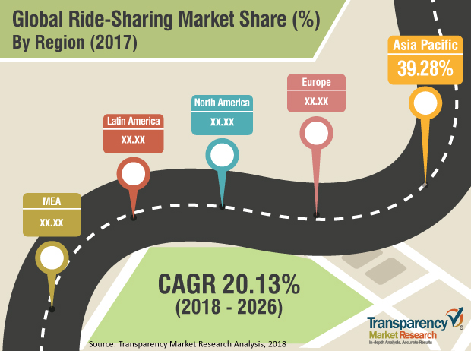
Conclusion
Simple Linear Regression model works well to predict the Fare for ride sharing service
Some spatial variables were converted to categorical variables for model
Time Series Analysis could be included in future model building

